Slide 1
ER-Modelling- Basics
ER Model Basics
Entity
Entity Type
Attribute
Attribute Type
Key and Key Attributes
Relationship
ER Diagram Example
References

Slide 2
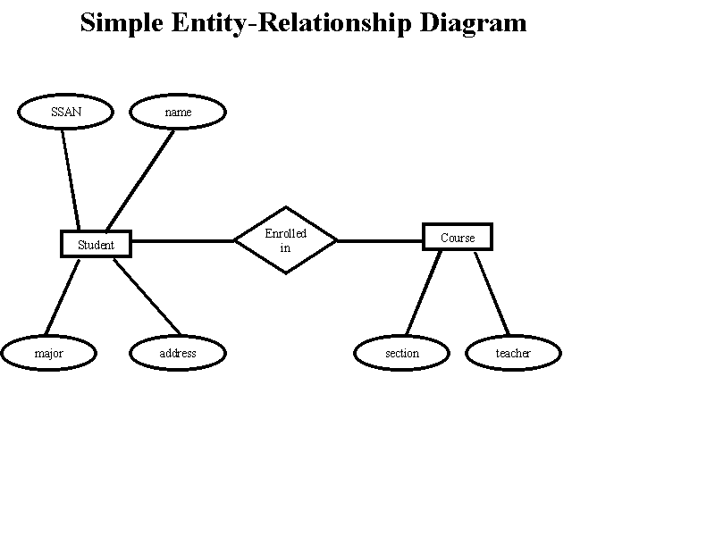
ER MODELING -TOP DOWN APPROACH
A design method which works on Conceptual level based on perception of real world.
A graphical technique for understanding and organizing the data independent of the actual database implementation.

Slide 3
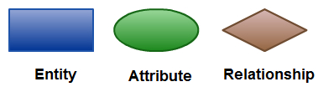
ER Model Basics
Entities (objects): Any thing that may have an independent existence and distinct from other entities based on their attributes.
e.g. Customers, Accounts, Trainee, Student etc.
Attributes: Properties/characteristics that describe a entity.
e.g.: Student Name, DOB, Address, etc.
Relationships: Associations between entities.
e.g. Account A-101 is held by customer Johnson etc.
ER MODELING - NOTATIONS

Slide 4
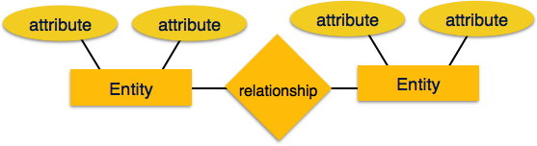
Attributes
Entity:
Real-world object distinguishable from other objects.
E.g. customers, accounts, bank branch
Entity Set:
A collection of similar entities. E.g., all employees.
Attribute describe the property of entity and relationship.
The set of possible values for an attribute is called the domain of the attribute.
e.g.: The domain of attribute “marital status” is having four values: single, married, divorced or widowed.
e.g. :The domain of the attribute “month” is having twelve values ranging from January to December.

Slide 5
Attributes Types
Types of Attributes | Definition | Example
Simple attribute | Cannot be divided into simpler components | Gender of the employee
Composite attribute | Can be split into components | Address of the employee
Single valued | Can take on only a single value for each entity instance | Age of the employee
Multi-valued | Can take up many values | Skill set of the employee
Stored Attribute | Attribute that need to be stored permanently | Date of joining of the employee
Derived Attribute | Attribute that can be calculated based on other attributes. | Years of service of the employee

Slide 6
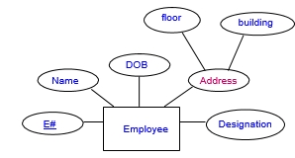
ER MODELING - NOTATIONS
Composite attribute
Represented by an ellipse from which other ellipses emanate and represent the component attributes. E.g Address

Slide 7
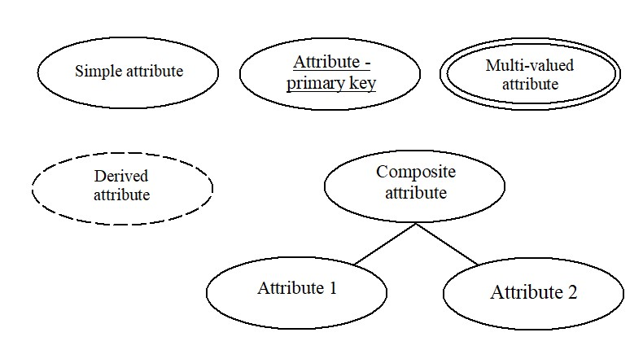
Key Attributes
A group of one or more attributes that uniquely identify an entity in the entity set. i.e. the attribute (or combination of attributes) that is unique for every entity instance.
e.g.: the account number of an account, the employee id of an employee etc.
ER MODELING - NOTATIONS

Slide 8
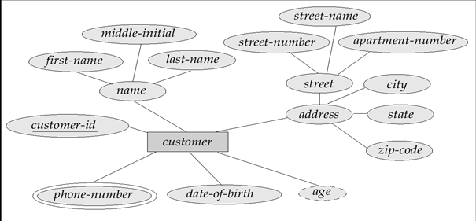
ER MODELING - Example

Slide 9
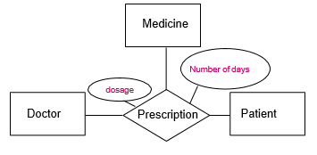
Entity Types
Regular Entity: Entity that has its own key attribute (s).
e.g.: Employee, student ,customer, policy holder etc.
Weak entity: Entity that depends on other entity for its existence and doesn’t have key attribute (s) of its own.
e.g. : spouse of employee
Relationship
Association among two or more entities. i.e. Any entity can be related to other entities via relationships.
e.g.: A supplier may supply some part.
Attributes of a Relationship
These attributes best describe the relationship prescription rather than any individual entity Doctor, Patient or Medicine.

Slide 10
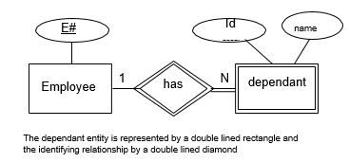
ER MODELING - NOTATIONS
Identifying Relationship
The identifying relationship is the one which relates the weak entity (dependant) with the strong entity (Employee) on which it depends.
Id is underlined with a dotted line because it is used to form composite key of dependent entity along with E#.

Slide 11
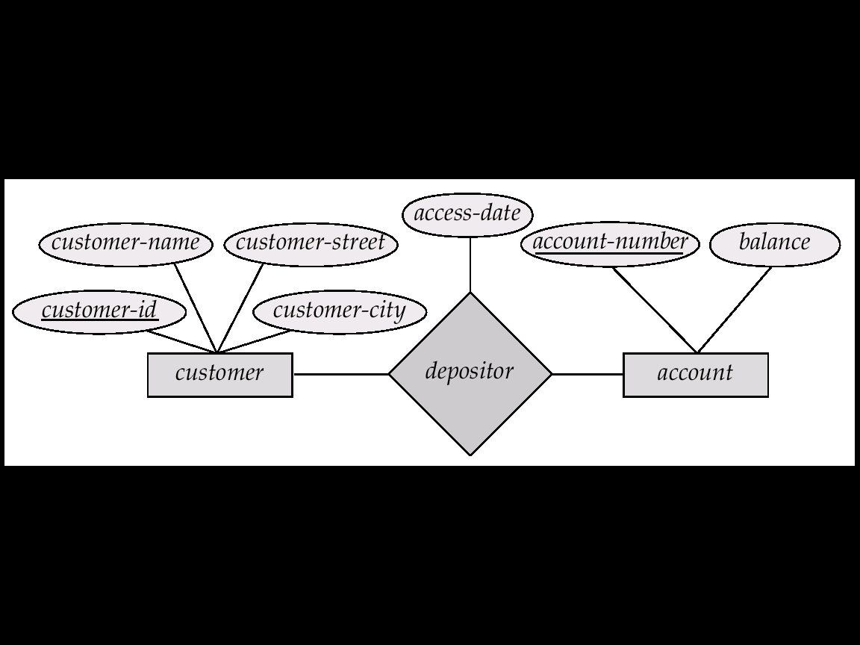
ER MODELING - Example
Bank Information System

Slide 12
Degree of a Relationship
Degree: the number of entity types involved
One Unary
Two Binary
Three Ternary
e.g.:
employee manager-of employee is unary
employee works-for department is binary
Customer purchases items from a shop keeper
Here customer purchase item, shop keeper is a ternary relationship

Slide 13
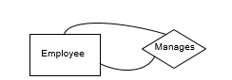
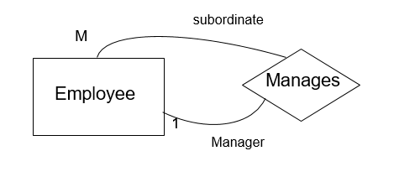
Unary Relationship
A unary relationship is represented as a diamond which connects one entity to itself as a loop.
The relationship above means, some instances of employee manage other instances of Employee.
Role names
Role names may be added to make the meaning more explicit

Slide 14
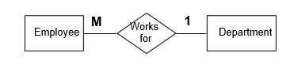
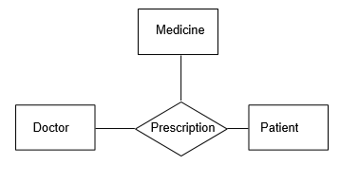
Binary Relationship
A relationship between two entity types
Ternary Relationship
A relationship connecting three entity types.

Slide 15
Cardinality
Relationships can have different connectivity
one-to-one (1:1)
one-to-many (1:N)
many-to-one (M:1)
many-to-many (M:N)
e.g.:
Employee head-of department (1:1)
Lecturer offers course (1:N) assuming a course is taught by a single lecturer
Student enrolls course (M:N)
The minimum and maximum values of this connectivity is called the cardinality of the relationship.

Slide 16
Relationship Participation
Total Participation: Every entity instance must be connected through the relationship to another instance of the other participating entity types
Partial Participation : All instances need not participate
e.g.: Employee Head-of Department
Employee: partial
Department: total
All employees will not be head-of some department.
So only few instances of employee entity participate in the above relationship.
But each department will be headed by some employee.
So department entity’s participation is total and employee entity’s participation is partial in the above relationship.

Slide 17
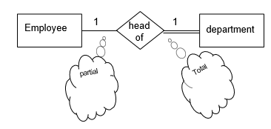
Relationship participation
All instances of the entity type Employee don’t participate in the relationship, Head-of.
Every employee doesn’t head a department. So, employee entity type is said to partially participate in the relationship.
But, every department would be headed by some employee.
So, all instances of the entity type Department participate in this relationship. So, we say that it is total participation from the department side.

Slide 18






An Entity can be defined as an object or concept about which user wants to store information.
A weak Entity requires another Entity for it’s existence. Example Order Item depends upon Order Number for its existence. Without Order Number it is impossible to identify Order Item uniquely.
Properties or characteristics of an Entity is called Attributes of entity.
If an attribute is the unique or distinguishing characteristic of the Entity it is called Key Attribute
If an attribute can have more than one value then it is called multi-valued attribute.
For example, an employee Entity can have multiple skill values.
Copyright © 2008, Infosys Technologies Ltd. 47 Confidential

Slide 19




If the value of an attribute can be derived from another attribute it is called derived attribute. For example, an employee's monthly salary is based on the employee's basic salary and House rent allowance.
Relationships in ER Diagram illustrate how two entities of database share information.
We connect a weak entity through a strong entity using a weak relationship notation.

Slide 20

Customer
 | 1
Cardinality of relationship tells how many instances of an Entity type is relate to one instance of another Entity Type.
M,N both represent ‘MANY’ and 1 represents ‘ONE’ Cardinality
N
Account
Transaction
1
M
An entity can be self linked.
For example, employees can supervise other employees
Copyright © 2008, Infosys Technologies Ltd.
49
Confidential

Slide 21
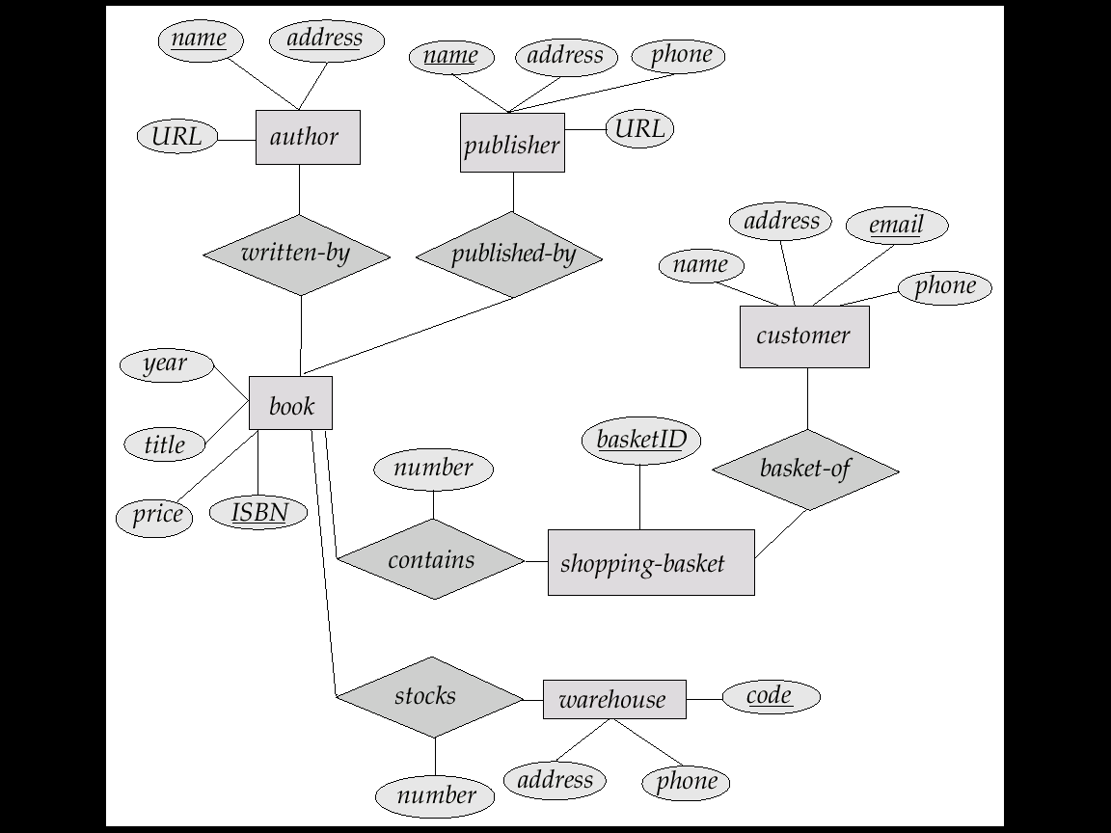
ER MODELING - Example
On Line Book Shop

